Slide 1
NestJs
Nest is a framework for building efficient, scalable Node.js server-side application.

Slide 2
What is NestJs
It uses progressive JS, built with and fully supports Typescript.
But developers can use pure JS.
Combines elements of OOP, FP, FRP(functional reactive programming).
Behind the seen Nest use robust HTTP Server frameworks (like Express).
With this framework developers can create: highly testable, scalable, loosely coupled, and easily maintainable applications.
The architecture is heavily inspired by Angular.

Slide 3
Install NestJs
To get started, scaffold(creating a structure) the project with the Nest CLI, or clone a starter project.
To run npm you should have node.js in your machine.
Nestjs/cli ➔ nest, helps us to deal with NestJs concepts in the code.
$ npm i –g @nestjs/cli
$ nest new project-name

Slide 4
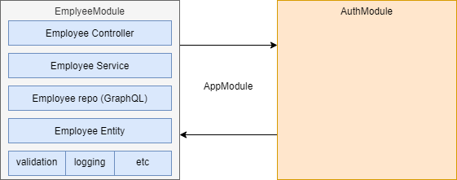
Sample Application

Slide 5
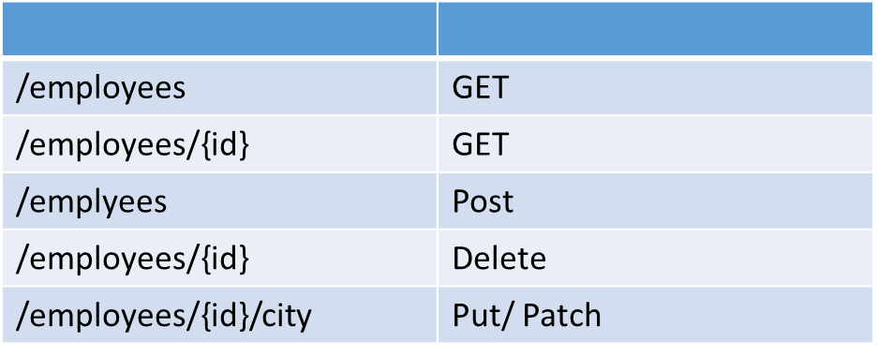
CRUD Operations

Slide 6
what we discuss
Modules, controllers, services and providers
Inter-layer communications and DI
Validations
CRUD with Error handling
Best practices
Logging
Security
Config management

Slide 7
Cont..
Use GraphQL as data layer and GraphQL federation
Securing Application
Debug NestJS projects

Slide 8
Modules
Each application has attest one module, a root module.
The root module is starting point Nest uses to build the application graph.
Spring IOC (inversion of control) (dependency injection):
Through constructor arguments, properties that are set on object.
Nest IOC →to DI. To bootstrap nestIOC root module used as starting point.
Nest recommended way is use modules to each of your components.
By doing this we can achieve oop solid principles.

Slide 9
Modules
Providers | The providers will be instantiated by the Nest injector, and that may be shared at least across this module.
Controllers | The set of controllers defined in this module… which have to be instantiated.
Imports | The list of imputed modules… that export the providers which are required in this module
exports | The subset of providers that are provided by this module. and should be available in other modules which import this module.

Slide 10
Note..
Module encapsulates provides by default. So, you may consider Exported providers from a module as the module’s public api, or interface. Other wise cant inject provider.
In Nest, modules are singletons(one instance for this class) by default. Thus, you can share the same instance of any provider between multiple modules.

Slide 11
Shared modules..
Every module is automatically a shared module.
Once created a module can be reused by any module.
Want to share the instance of the EmployeeService, between seveal modules.
Export the EmpoyeeService provider. @Module{ exports: [EmpoyeeService]

Slide 12
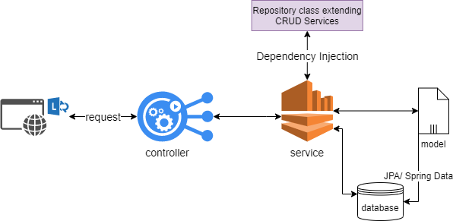
Spring architecture

Slide 13
Codding
employee-service\src $ nest g module employees
Every thig we create related to src folder.
src/employees/employees.module.ts
src/app.module.ts ➔ @Module{ imports: [EmpoyeesModule]
For the module I need to create services to get employee’s data.
src/employees/employees.controller.ts
src/employees/employees.module.ts ➔ @Module{ controllers: [EmpoyeesModule]
employee-service\src $ nest g controller employees

Slide 14
Providers
Providers are a fundamental concept in Nest.
Controllers should handle HTTP requests and delegate complex tasks to providers.
Providers are JS plain classes that are declared as providers in a module.
All Providers are not services. (All Services are Providers).

Slide 15
con…
Dependency injection:
Don’t hardwire dependencies with in the code.
Ioc framework resolve dependencies for us.
Less number of objects.
Reuse objects.
Avoid creation times for objects.
When you mark some class as @injectable()
Controller request (get: /employees): I need employee service.
Now we have a dependency (employee service): check any employee service compatible instance in nest runtime(IOC) engine. If not create once(singleton).

Slide 16
Codding
employee-service\src $ nest g service employees --no-spec
src/employees/employees.service.ts
src/employees/employees.module.ts ➔ @Module{ providers: [EmpoyeesService]
EmployeeService is injectable so itcan be resolved at runtime. This dependence need to controller. === controller delegate req to service.
To inject Employee Service to out code
Property based injection.
Constructor based injection.

Slide 17
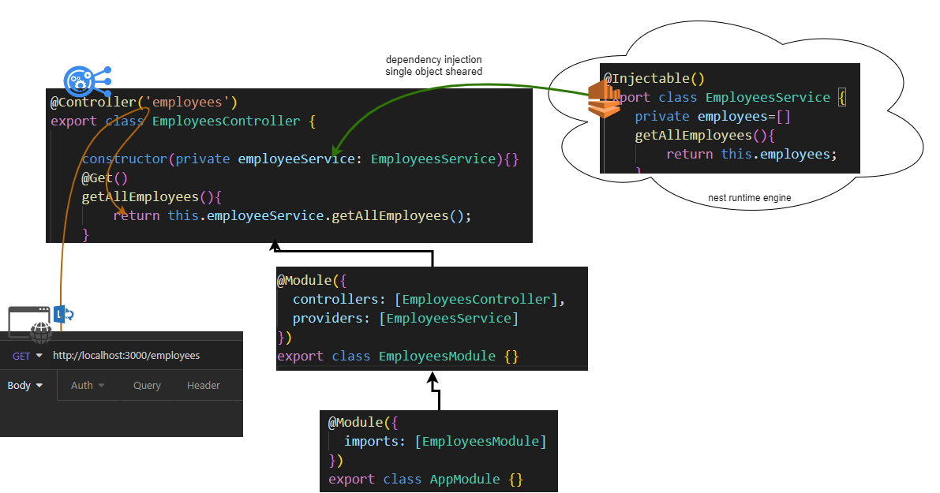
Codding

Slide 18
Codding
employee-service\src $ nest g service employees --no-spec
src/employees/employees.service.ts
src/employees/employees.module.ts ➔ @Module{ providers: [EmpoyeesService]
EmployeeService needs Employee object. How employee looks likes.
Employee.model.ts → can be interface/ class (but js has only class)
This package uses to generate id. When new object created.
employee-service $ npm i uuid

Slide 19
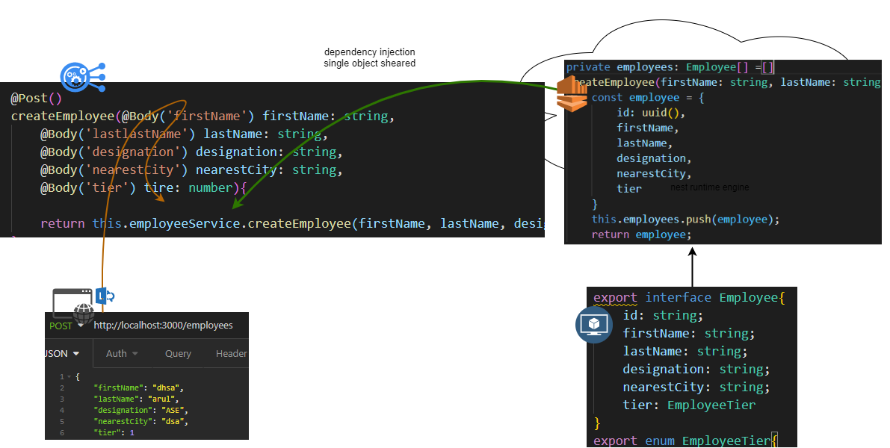
Codding

